Slide 1
Differential Privacy in statistical databases
PROF-PERIKLIS PAPAKONSTANTINOU
KARISHMA SAWANT

Slide 2
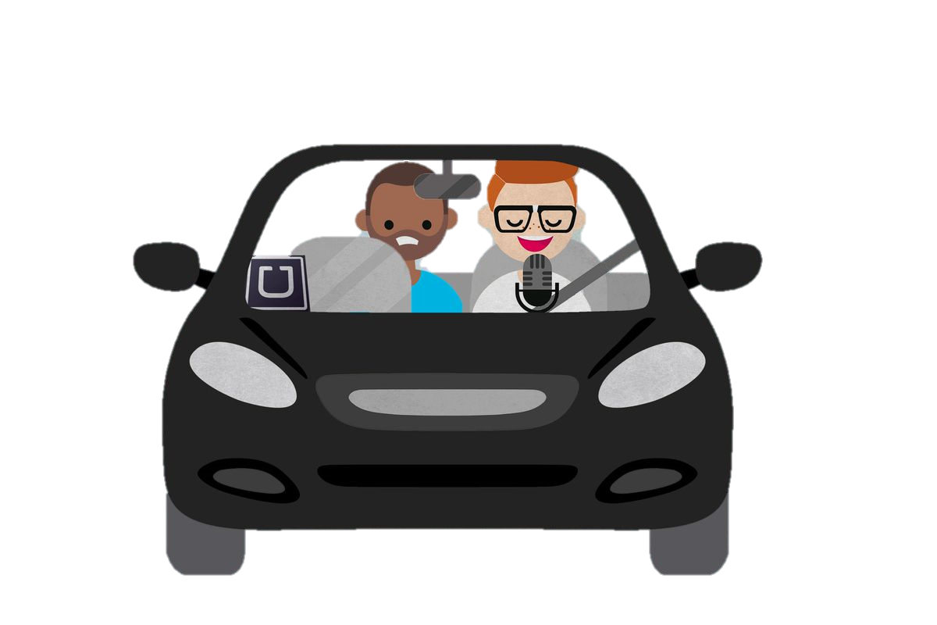
definition
Data Privacy makes it possible to collect and share aggregate information about the users without invading their privacy.
Example: UBER

Slide 3
techniques
THERE ARE MECHANISM LIKE
Ε-DIFFERENTIAL PRIVACY
THE LAPLACE MECHANISM
SENSITIVITY
RANDOMIZED RESPONSE MECHANISM
COMPOSABILITY.

Slide 4
RANDOMIZED RESPONSE MECHANISM
IT IS A RESEARCH TECHNIQUE THAT ALLOWS RESPONDENTS TO RESPOND TO SENSITIVE ISSUES WHILE MAINTAINING THEIR CONFIDENTIALITY.

Slide 5

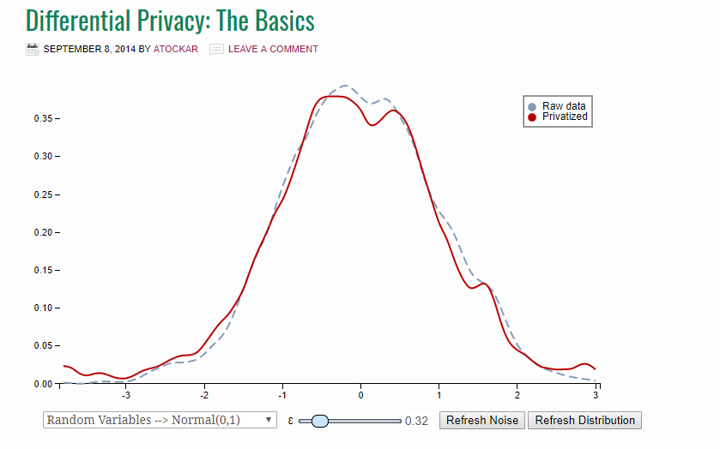
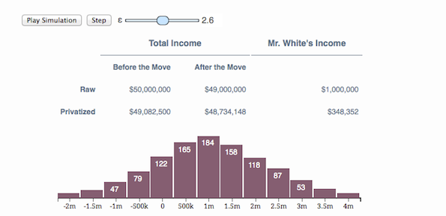
THE LAPLACE MECHANISM
A randomized function K gives ε-differential privacy if for all data sets D and D′ differing on at most one row, and all S ⊆ Range(K)
Histogram
Density plot

Slide 6
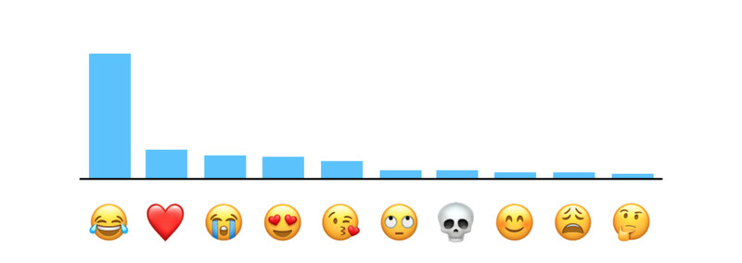



industries
Apple: Favorite Emojis, Keyboard and Notes
To obscure an individual’s identity, Differential Privacy adds mathematical noise to a small sample of the individual’s usage pattern. As more people share the same pattern, general patterns begin to emerge, which can inform and enhance the user experience. From iOS 10 onwards, this technology helped to improve QuickType and emoji suggestions and Lookup Hints in Notes.
Google: Browsing History, Location Tracker, Gboard and Play Store

Slide 7
References.
https://www.infoq.com/articles/differential-privacy-intro
http://theconversation.com/explainer-what-is-differential-privacy-and-how-can-it-protect-your-data-90686
https://blog.cryptographyengineering.com/2016/06/15/what-is-differential-privacy/
https://en.wikipedia.org/wiki/Randomized_response
https://www.wired.com/2016/06/apples-differential-privacy-collecting-data/

Slide 8

THANK YOU

